Slide 1
THE BRAIN Vs. EMOTIONS
THE JOURNEY OF A HUMAN
PRESENTERS:
KREETY KHATRI PULKIT PANDEY
2K19/EP/045 2K19/EP/076

Slide 2
ACKNOWLEDGEMENT
Presentation, Inspiration and Motivation have always played a key role in success of any project.
We express our deep sense of gratitude to Dr Parinita Sinha, Assistant Professor, Department of Humanities, DTU to encourage us to highest peak and to provide with the opportunity to prepare the project. We are immensely obliged to her for her elevating inspiration, encouraging guidance and kind supervision in the completion of the project. We are also thankful for her invaluable constructive criticism and advice throughout the working of the project.
The accomplishment of the project was due to our equal efforts and contribution.
.

Slide 3
CONTENTS
OBJECTIVE
PROJECT OVERVIEW
PROJECT SCOPE
INTRA-UTERINE STAGE
POST-NATAL DEVELOPMENT
SURVEY RESULTS
.

Slide 4
01
OBJECTIVE

Slide 5
02
STAGES
OF
HUMAN LIFE

Slide 6
ADULTHOOD
CHILDHOOD
05
04
03
02
01
OLD-AGE
ADOLESCENCE
INFANCY

Slide 7
ADULTHOOD
CHILDHOOD
05
04
03
02
01
OLD-AGE
ADOLESCENCE
INFANCY
INTRA-UTERINE
POST-NATAL

Slide 8
EARLY
TEENAGE
ADULTHOOD
CHILDHOOD
05
04
03
02
01
OLD-AGE
ADOLESCENCE
INFANCY

Slide 9
ADULTHOOD
CHILDHOOD
05
04
03
02
01
OLD-AGE
ADOLESCENCE
INFANCY
LATER TEENAGE
EARLY ADOLESCENCE

Slide 10
EARLY
MIDDLE
ADULTHOOD
CHILDHOOD
05
04
03
02
01
OLD-AGE
ADOLESCENCE
INFANCY

Slide 11
ADULTHOOD
CHILDHOOD
05
04
03
02
01
OLD-AGE
ADOLESCENCE
DEATH
LATER ADULTHOOD
INFANCY

Slide 12
03
PROJECT
SCOPE

Slide 13
INFANCY
01
02
INTRA-UTERINE STAGE
NEW-BORN
EMOTIONS
PHYSIOLOGY

Slide 14
04
INTRA-UTERINE
STAGE

Slide 15
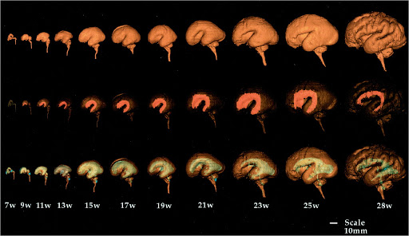
PHYSIOLOGICAL VARIATIONS

Slide 16
PHYSIOLOGICAL VARIATIONS

Slide 17
PHYSIOLOGICAL VARIATIONS

Slide 18
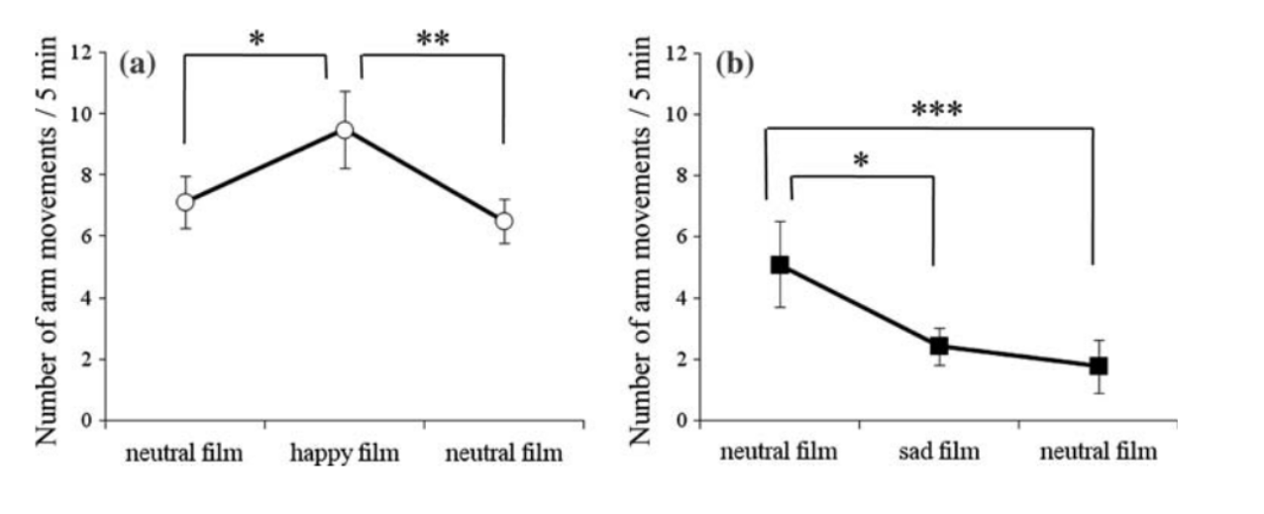
PHYSIOLOGICAL VARIATIONS
HAPPINESS GROUP
SADNESS GROUP

Slide 19
EMOTIONAL VARIATIONS

Slide 20
EMOTIONAL VARIATIONS
BIOCHEMICAL CHANGES
80%
90%
30%
35%
HIGH
CORTISOL
HIGH
EEG ACTIVATION
LOW
DOPAMINE
LOW
SEROTONIN

Slide 21
EMOTIONAL VARIATIONS

Slide 22
05
POSTNATAL
STAGE

Slide 23
PHYSIOLOGICAL VARIATIONS
THE BRAIN
THALAMUS
Relays information
HYPOTHALAMUS
homeostasis
AMYGDALA
emotion
BRAIN STEM
HIPPOCAMPUS
Memory conversion

Slide 24
PHYSIOLOGICAL VARIATIONS
THE BRAIN
Reflexive Motor and Vital functions such as flow of messages throughout the body.
Genetic and Reflexive Sensory Control
THE BRAIN
STEM

Slide 25
PHYSIOLOGICAL VARIATIONS
THE BRAIN
Hunger and Thirst satisfaction.
Experience and Expression of Emotion.
THE LIMBIC
SYSTEM

Slide 26

PHYSIOLOGICAL VARIATIONS
THE BRAIN

Slide 27
06
POSTNATAL
STAGE
EMOTIONAL DEVELOPMENT

Slide 28
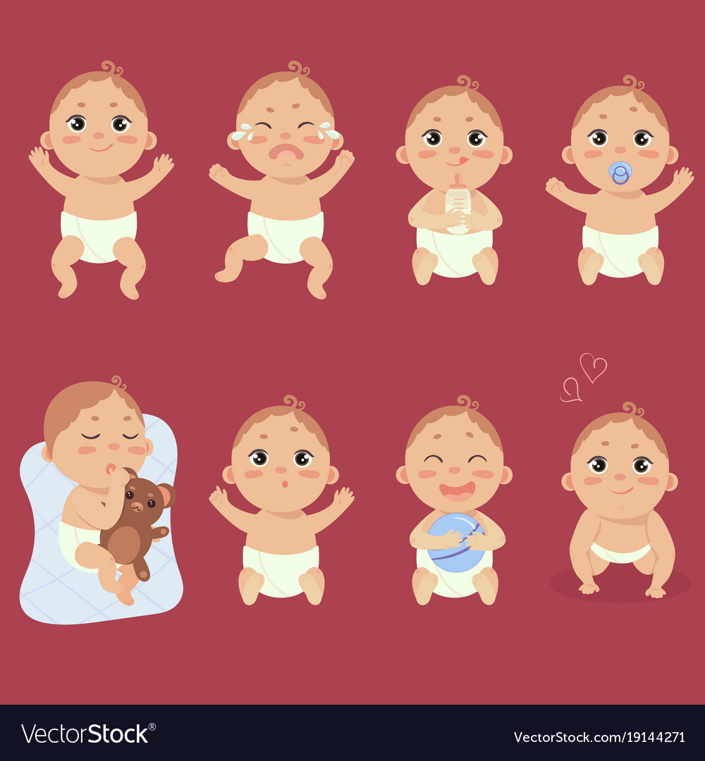
Early Emotional Response

Slide 29
Early Emotional Response
01
02
The capacity to approach or withdraw from stimulation is a key aspect of emotional life
ATTRACTION
WITHDRAWAL
Attraction to pleasant situations that bring comfort, stimulation, and pleasure.
.
Withdrawal from unpleasant situations

Slide 30

Early Emotional Response
01
02
The capacity to approach or withdraw from stimulation is a key aspect of emotional life
ATTRACTION
WITHDRAWAL
Attraction to pleasant situations that bring comfort, stimulation, and pleasure.
.
Withdrawal from unpleasant situations

Slide 31
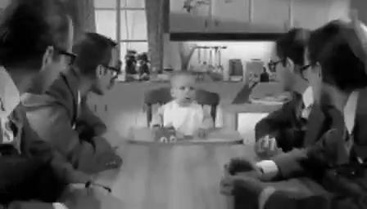
EARLY EMOTIONAL RESPONSE
CUROSITY
MOTIVATION
ATTRACTION
WITHDRAWL
RESILIENCE
EXPLORATION

Slide 32

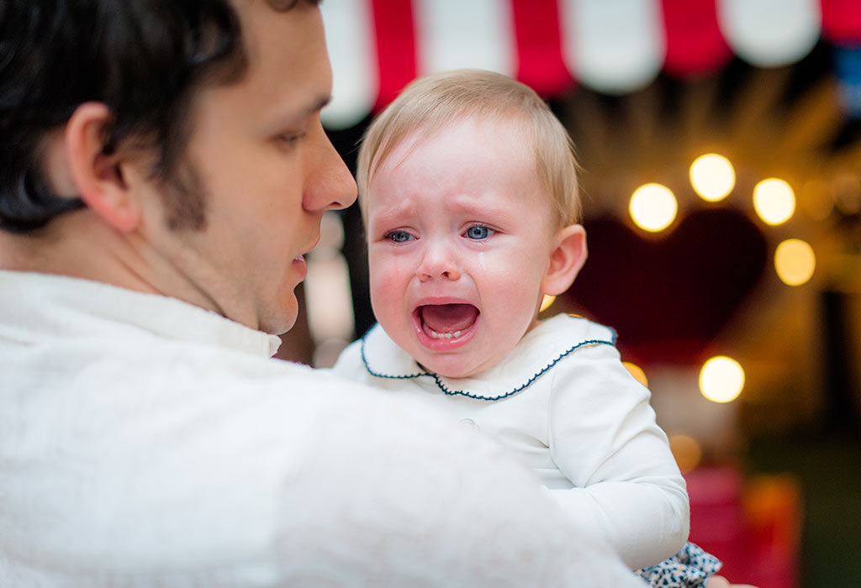
Emotions and The Brain
Stranger Warriness
Stranger Anxiety

Slide 33
Emotions and The Brain
TRUST
CO-OPERATION
MISTRUST
UNFAMILIAR

Slide 34
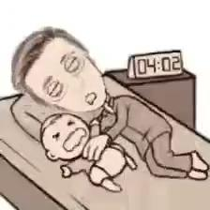
01
ATTACHMENT
02
03
Separation Anxiety

Slide 35
01
ATTACHMENT
02
AWARENESS
03
ROUGE TEST

Slide 36
01
ATTACHMENT
02
AWARENESS
03
ROUGE TEST

Slide 37
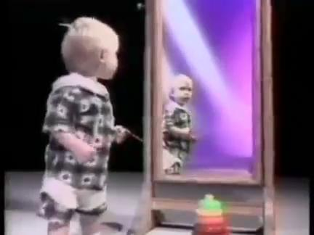
Self Recognition Test
GUILT
SHAME
PRIDE
SYMPATHY

Slide 38
Moving Towards Conclusion
UPBRINGING
CHANNELISE
ME
INTERPRET
I
PROCESS
GENETICS
RECOGNISE

Slide 39
07
SURVEY
CONDUCTED

Slide 40
CONSOLIDATED QUESTIONNAIRE
RESULTS
60%
Strongly Agree:
Varying Emotions and Physiological Reaction
30%
10%
Moderately Agree:
Varying Emotions and Physiological Reaction
Deny

Slide 41
08
FUTURE
SCOPE

Slide 42
ADULTHOOD
CHILDHOOD
05
04
03
02
01
OLD-AGE
ADOLESCENCE
INFANCY

Slide 43
What children need is a patient heart that listens rather than a brilliant mind that criticizes, open arms that accept rather than keen eyes that sees mistakes, gentle hands that lead rather than a harsh voice that commands.
Source : afineparents.com

Slide 44
THANKS

